Slide 1

Foreign and Emerging Animal Disease Updates
Tracie Guy, DVM
Veterinary Program Manager-Swine and Small Ruminants

Slide 2
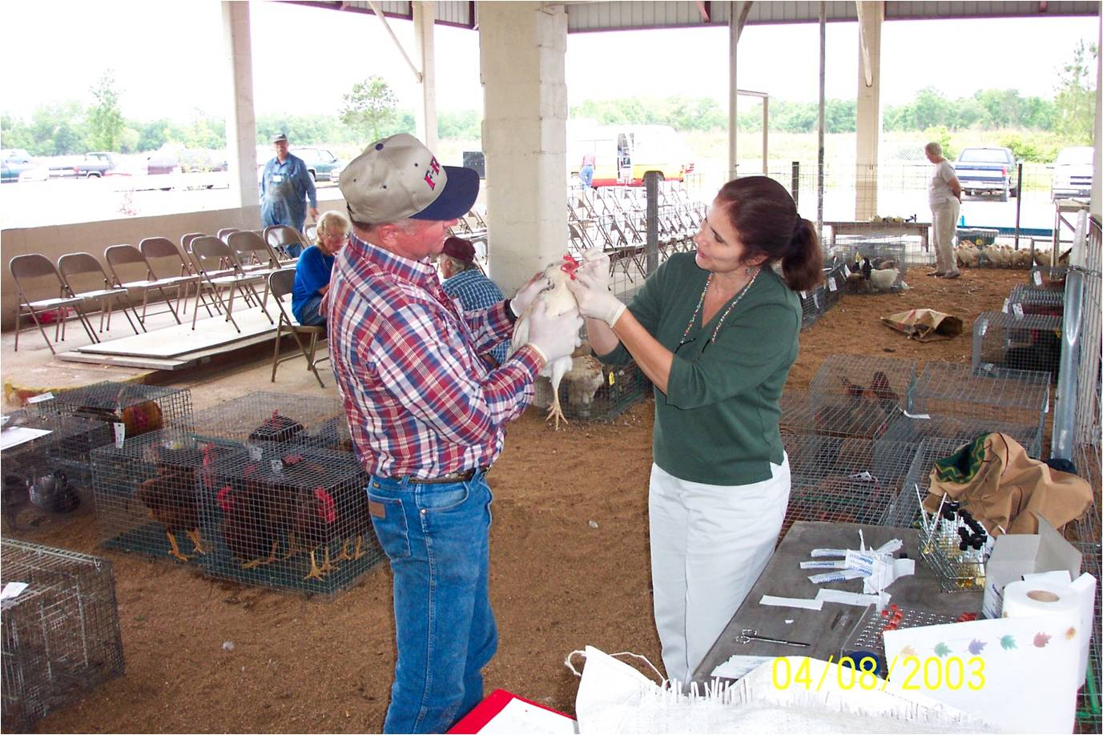
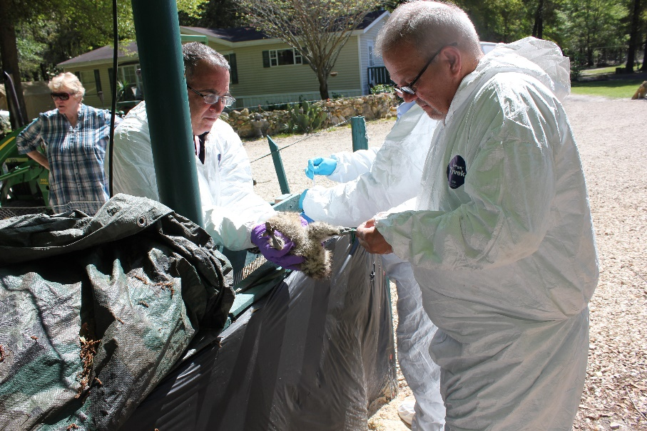
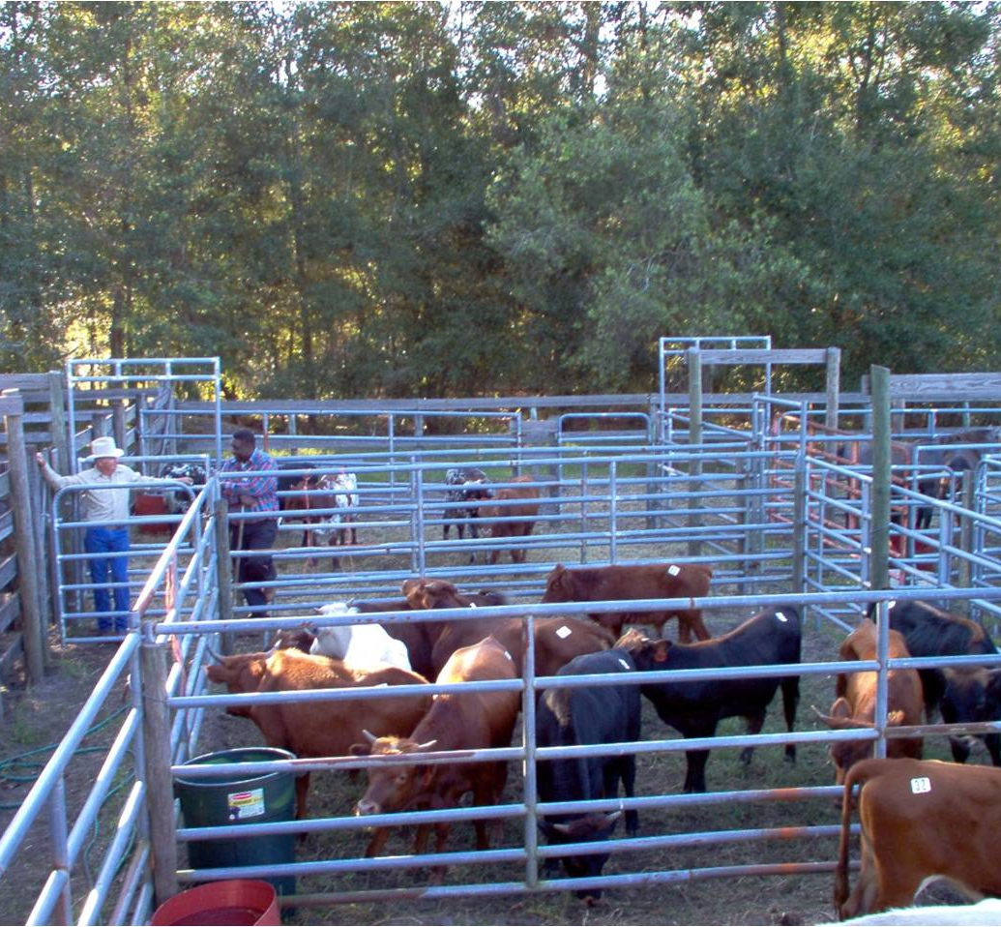
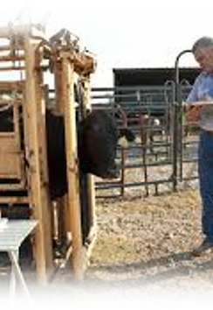
Division of Animal Industry
Mission Statement:
The Division of Animal Industry is responsible for enforcing animal health regulations in Florida and protecting the state from animal pests and diseases.

Slide 3
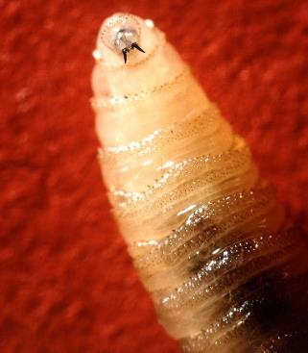
New World Screwworm Myiasis
Cochliomyia hominivorax
One of few known insects to consume living tissue of warm-blooded animals
Female can deposit eggs in wounds as small as tick bites
  Navel
  Nasal passages
  External genitalia
  ***Feeds on living flesh***
Notes:
Screwworm myiasis is caused by a parasitic infection of they fly larvae of the family Calliphoridae.
The New World Screwworm is a member of this family and its scientific name is Cochliomyia hominivorax (New World Screwworm).
The New World Screwworm is found primarily in warmer regions of the Western Hemisphere.
Any warm-blooded animal, including humans, is susceptible to infestation. It has rarely been seen in birds and only anecdotal reports in reptiles..
New World Screwworm Larvae (maggots) are unique in requiring living flesh for development.

Slide 4
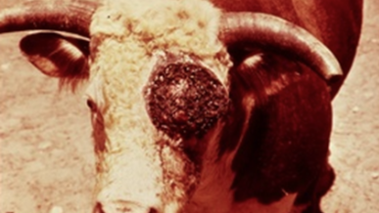
New World Screwworm Myiasis
Clinical Signs
  Wounds in living animals infested with maggots
  Smell of decaying flesh
  Head shaking
  Blood-tinged discharge from infected wounds
  Fly strike evidence
  Discomfort
  Depressed/not eating
  Decreased milk production
  Seclusion from herd/flock
Notes:
Any open wound can become infested and is often, but not always, characterized by foul-smelling exudate and the presence of larvae within the tissue.

Slide 5
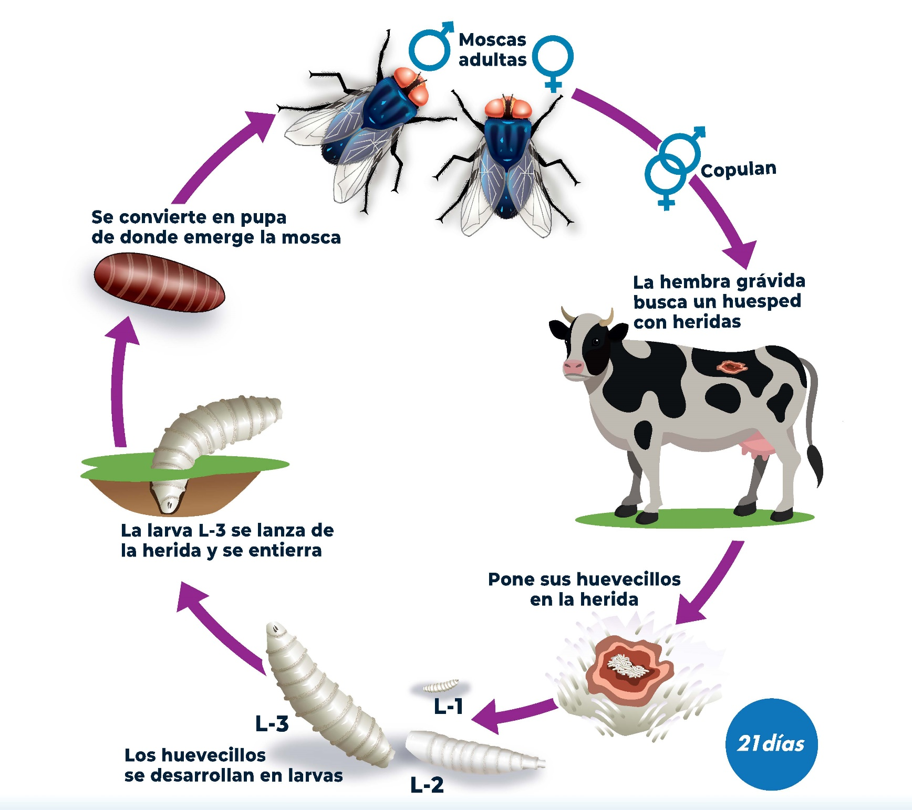
Entire cycle as fast as 21 days
Life cycle of New World Screwworm (Cochliomyia hominivorax)
Adult Flies
Copulation
Transition into pupa and then the fly emerges
Gravid female fly searches for a host with a wound or orifice
Pupae 6-8 days
L-3 larvae fall from the wound or orifice and buries itself in the ground to pupate
Gravid female fly lays eggs on wound or orifice
Larvae 5-7 days
Eggs hatch in 12-24 hours
21 days
Larval Stage
(L-1, L-2, L-3)
Notes:
A few important points about the life cycle of NWS.
Females mate only once in their lifetime.
Females are attracted to a live animal’s wound and/or opening. This is a prime place to lay eggs. They can lay anywhere between 200-300 eggs at one time.
Openings can be from a tick bite, nose, eyes, or umbilicus in a newborn animal, wounds from dehorning, shearing, barbed wire fences, as well as shedding of antler velvet in deer.
Eggs hatch into larvae, or maggots, and burrow into healthy, living tissue, feeding for 3-7 days causing the wound to become bigger.
The entire NWS life cycle is only 21 days.

Slide 6
Why Is Screwworm Important?
New World Screwworm (NWS) poses health risks to pets, livestock, wildlife, and humans
Reintroduction could cost more than $1billion to the U.S. livestock industry
In a 1976 outbreak in Texas, 1.5 million cows and 330K goats were infested
The 2016-2017 NWS Florida Outbreak cost the USDA 3.2 million

Slide 7
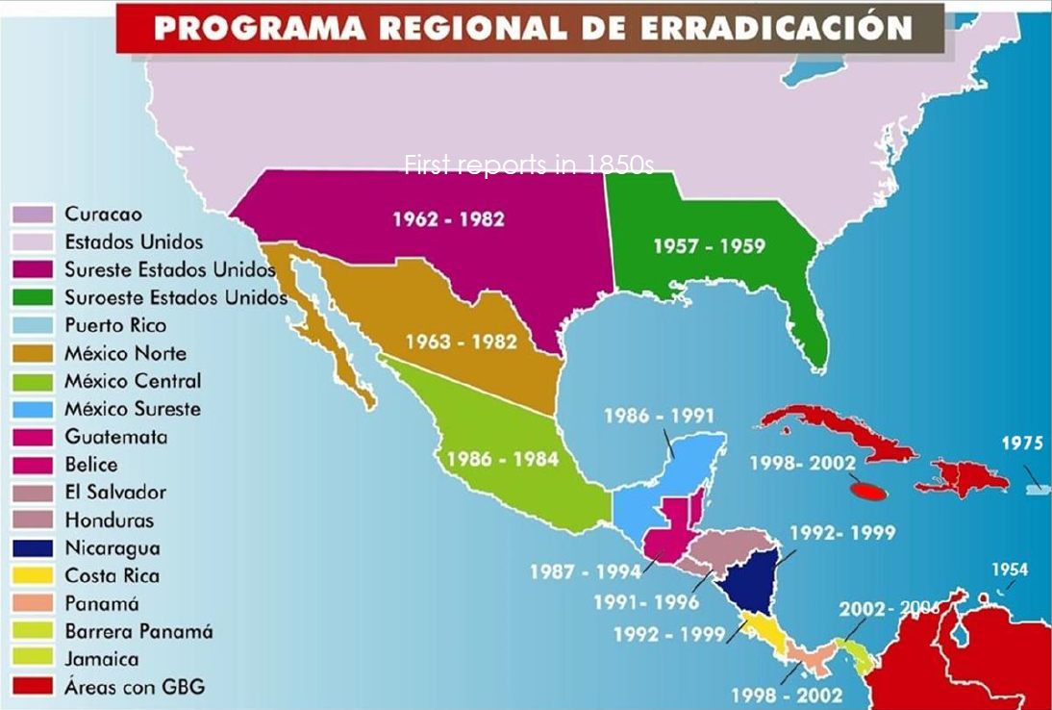
Notes:
Reports of NWS date back to the 1850s.
To combat this deadly and costly parasite, entomologists, Dr. Knilpling and Bushman, developed the Sterile Fly Technique working in field stations in TX and FL throughout the 19302-1950s.
The first successful deployment of this technique to eradicate screwworm occurred on the island of Curacao.
This success allowed for a larger scale effort in the US. The USDA in cooperation with state and local authorities worked to push NWS into Mexico.
The US was declared NWS free in 1966; however, infection was still an issue due to recurrent cases from Mexico.
The US formed and agreement with Mexico to eradicate NWS, and a few decades later, Mexico was declared free in 1991.
The eradication program was extended through Central America to create a permanent barrier to reinfestation.
Eradication efforts were focused on Panama and included the establishment of a sterile-fly production facility in the country.
By 2006, NWS had been pushed back to the Darien Gap, in hopes that this natural barrier would hold.

Slide 8
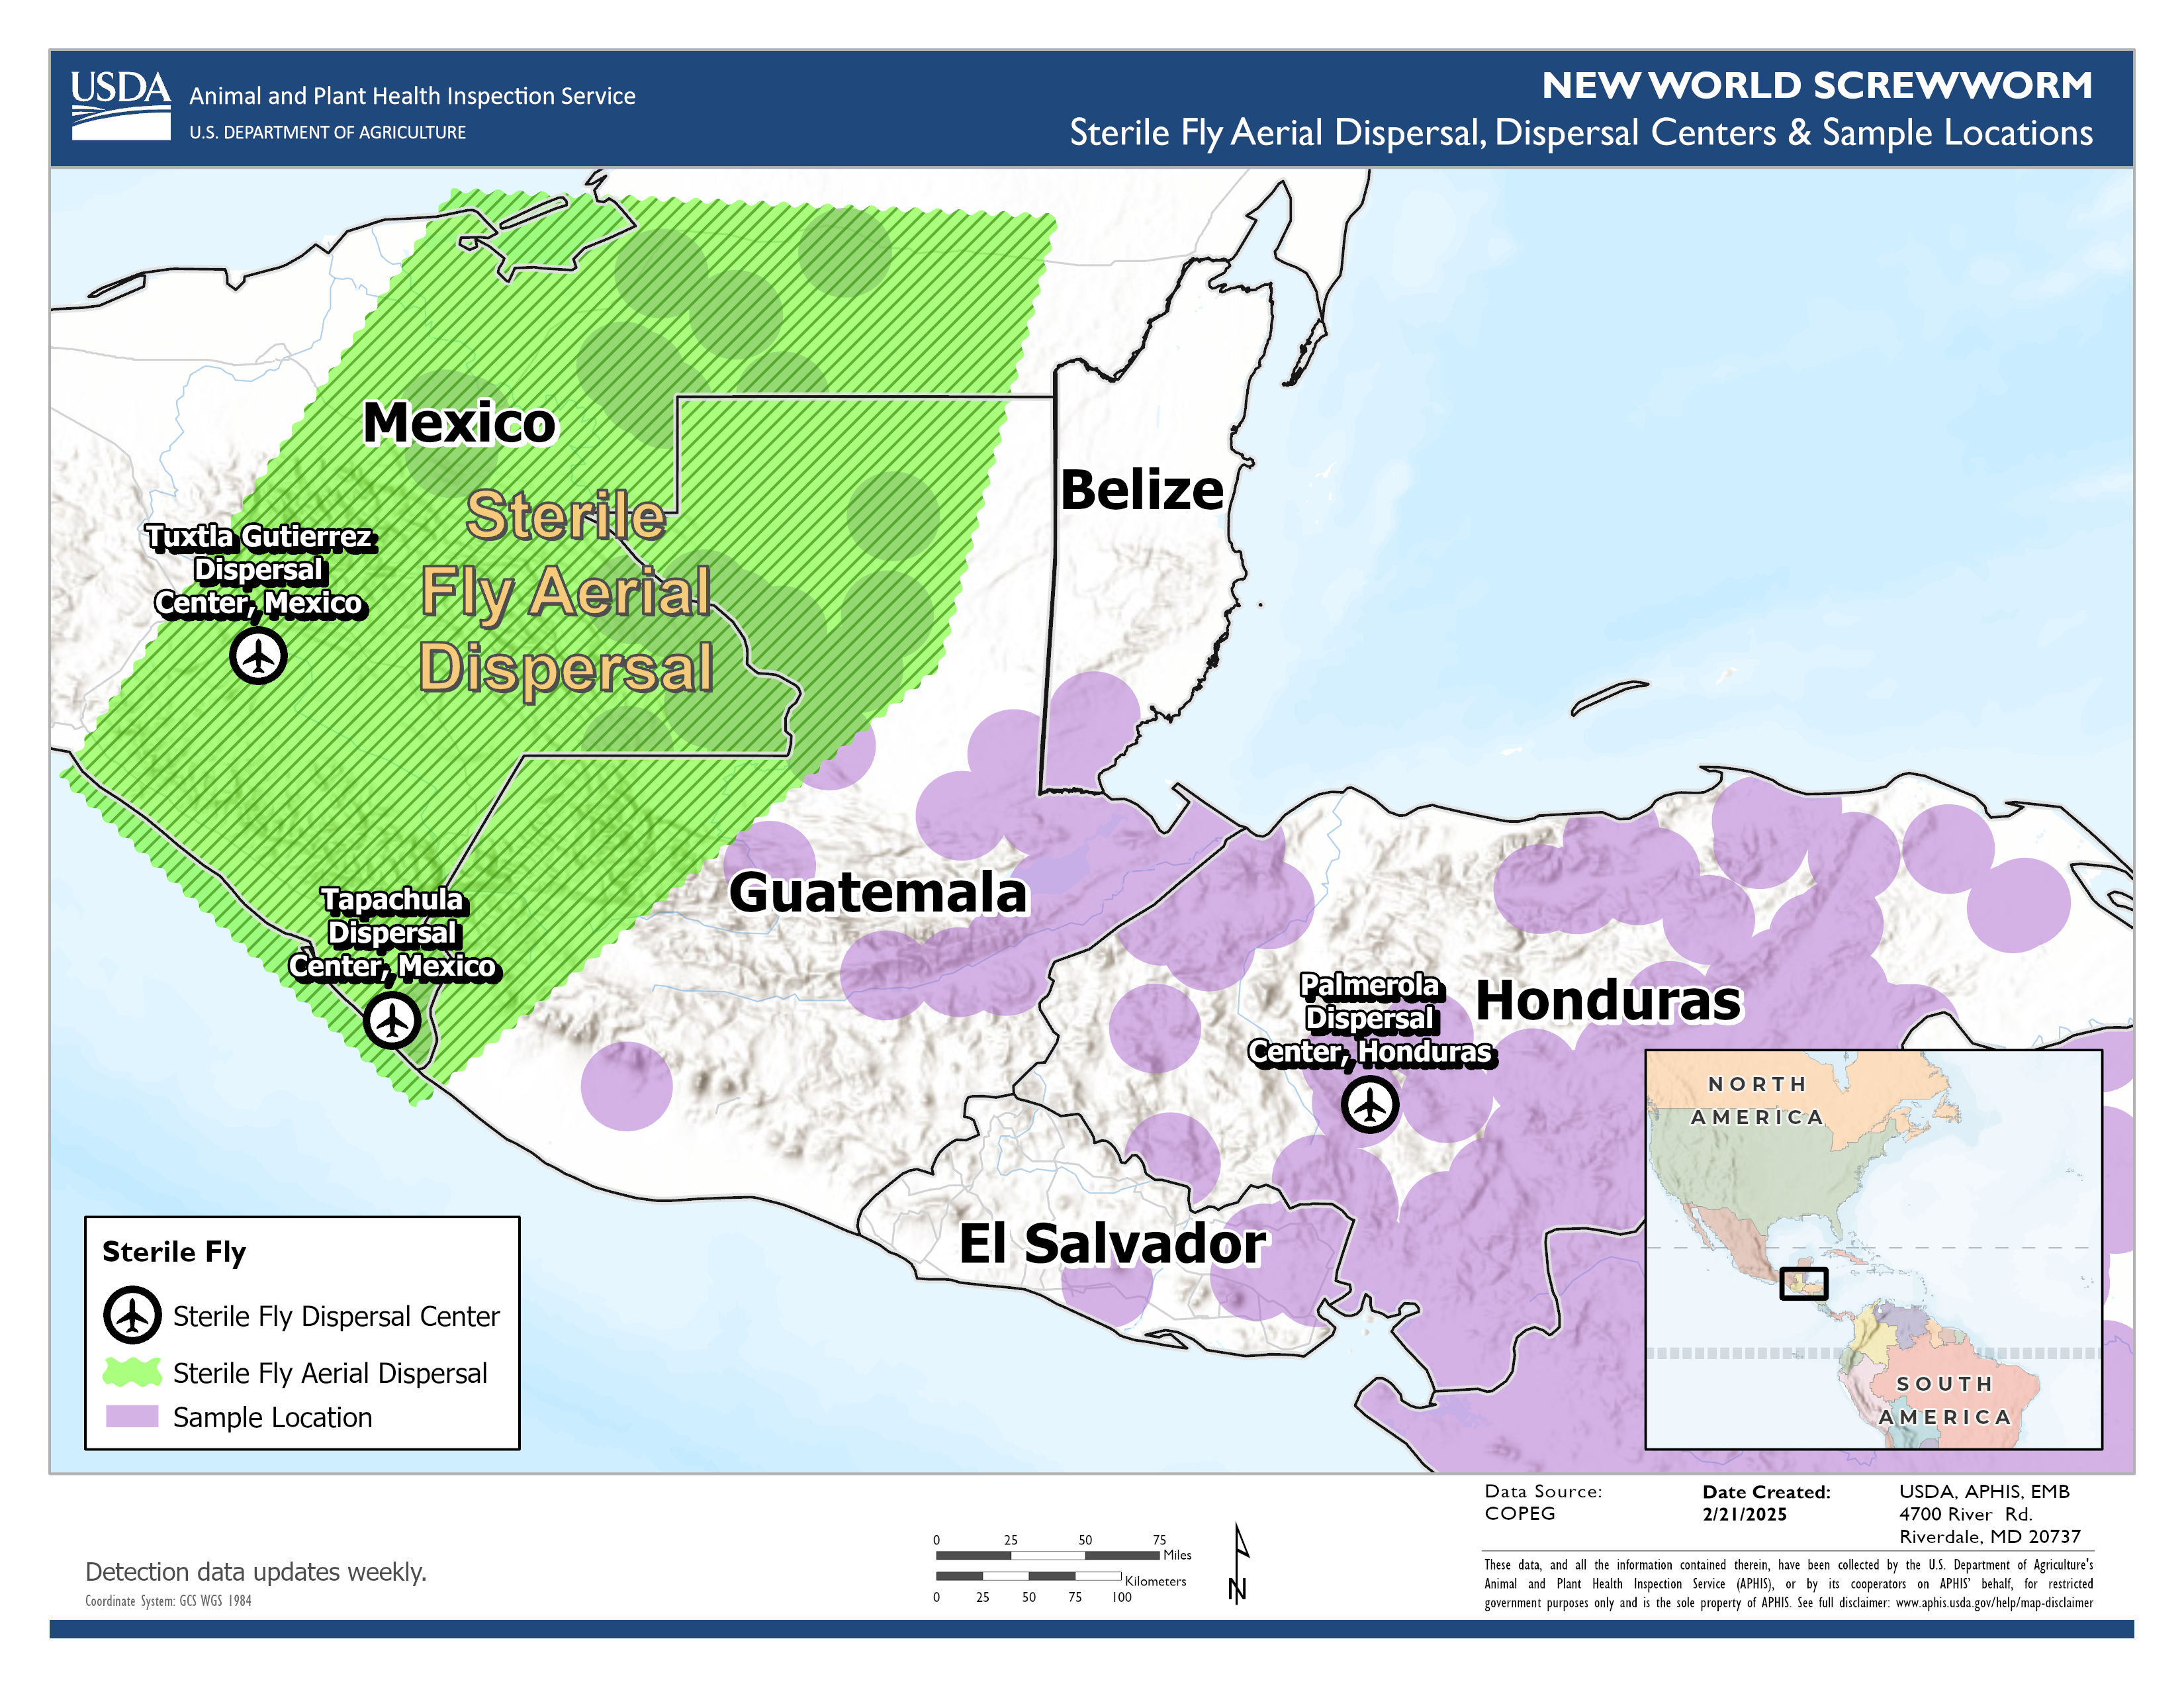
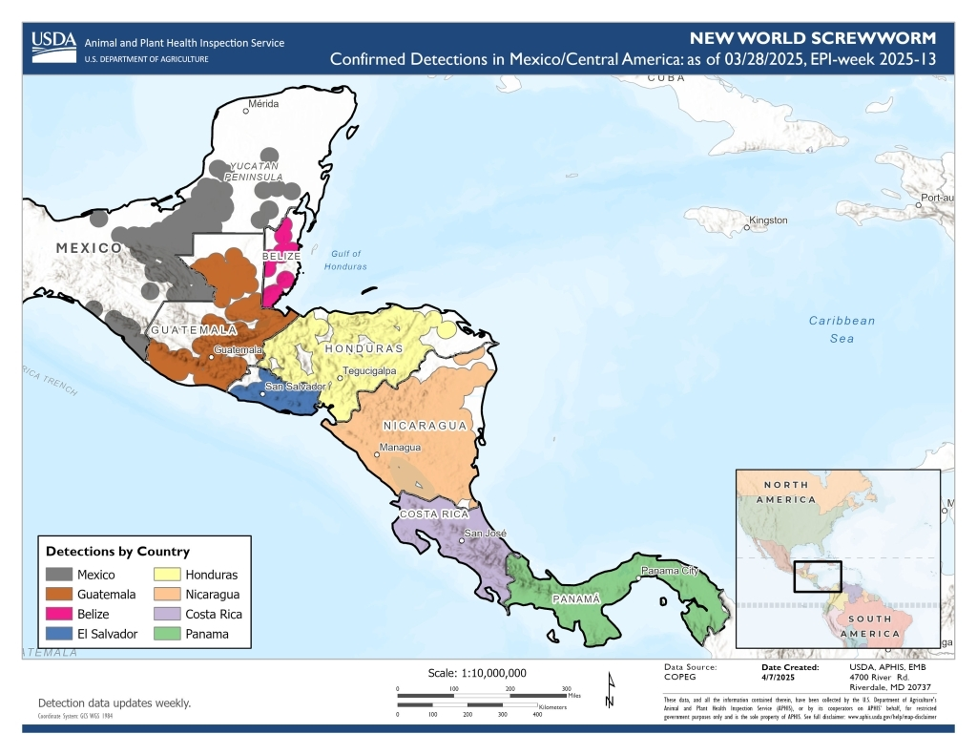
New World Screwworm
Notes:
In 2023 NWS detections in Panama rapidly increased from an average of 25 cases per year to 6500 cases in one year.
Since then, NWS has been detected in Costa Rica, Nicaragua, Honduras, Guatemala, Belize, El Salvador, north of the biological barrier that had successfully contained it to South America for decades

Slide 9
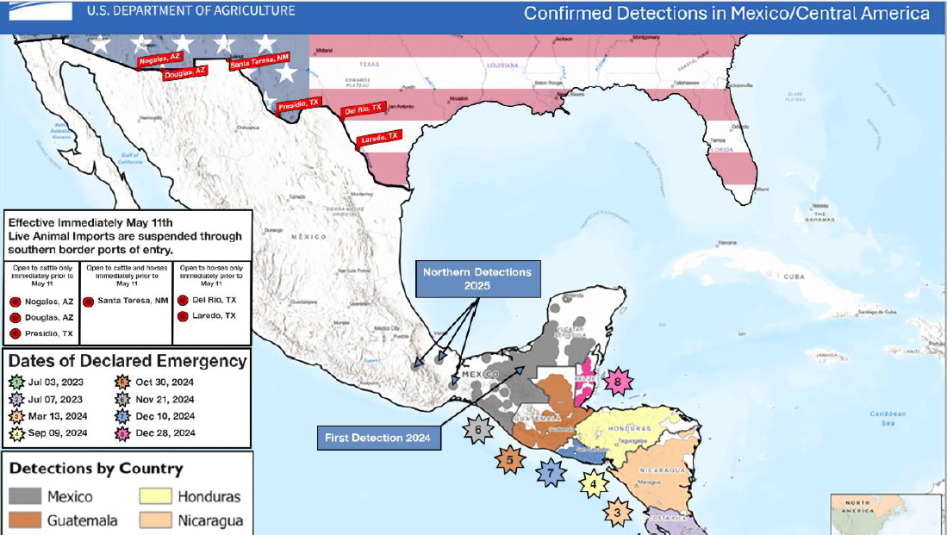
Notes:
In November 2024, the first case of NWS was reported in Southern Mexico.
And In 2025, NWS was detected North of the Isthmus of Southern Mexico.
More recently, NWS was detected in as far north as Oaxaca and Veracruz,, about 700 miles away from the US. Border.
As a result, USDA announced the suspension of live cattle, horse, and bison imports through U.S ports of entry along the southern border due to the continued rapid northward spread of New World Screwworm in Mexico.
The US continues to work with Mexico to stop the northern progression of NWS.

Slide 10
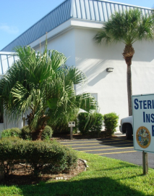
STERILE INSECT TECHNIQUE (SIT)
Sterile Insect Technique (SIT) is the only effective strategy for eliminating established NWS fly populations.
  This is considered one of the most environmentally friendly biological pest control methods ever developed. These are NOT genetically engineered flies.
NWS pupae are sterilized by low dose cobalt radiation exposure at the SIT Facility in Panama.
Adult males survive around 14 days; females tend to live around 10 days, but can live as long as 30 days.
Notes:
https://www.aphis.usda.gov/aphis/ourfocus/internationalservices/sterile_fly_release_programs/screwworm/screwworm_history

Slide 11
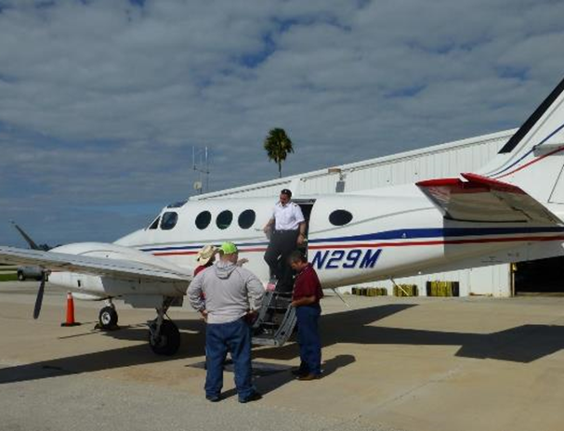
STERILE INSECT TECHNIQUE (SIT)
Millions of pupae are released twice weekly for 3-5 months beyond the last confirmed positive case in an animal. This increases the density of sterile males to breed wild females. Embryos in the resulting fertilized eggs fail to develop and the eggs do not hatch.
The females only mate once in their lifetime and the sterile flies cannot become an established population.

Slide 12
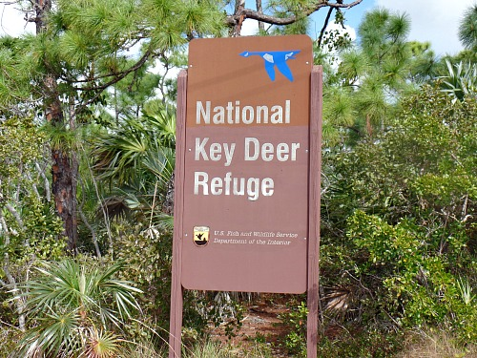
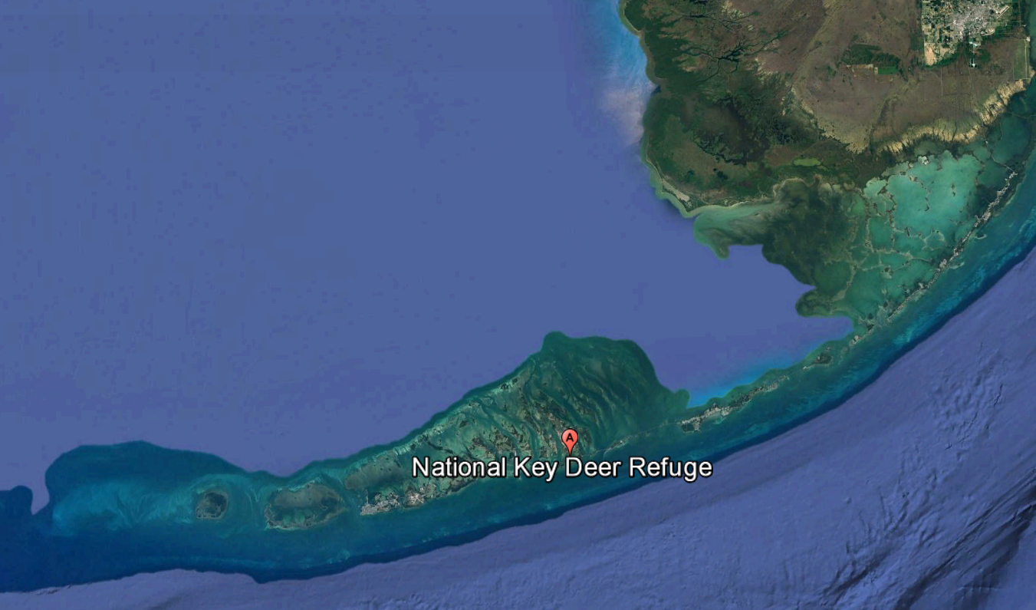
National Key Deer Refuge: 2016
Notes:
Only detection in US after eradication in the 1960s was in key deer in Florida in 2016. In coordination with USDA, FDACS employed the sterile fly technique and eradicated NWS in 2017.
A few stats from the response:
There were 400+ responders, 534 personnel deployments with state, local, and USDA working together.
Over 730 fly site assessments were conducted and over 188 million flies were released.
We ask all animal health personnel to remain vigilant against this parasite. If you suspect a case, please contact FDACS.

Slide 13
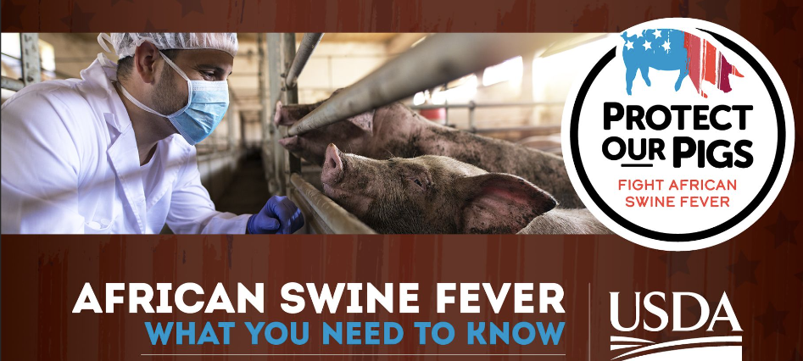

Slide 14
HISTORY of HEMORRHAGIC SWINE VIRUSES
CLASSICAL SWINE FEVER
First confirmed in the US in 1833
Endemic in the late 19th and 20th century
Eradicated from US by 1976!
Still endemic in parts of the Caribbean, DR and Haiti
AFRICAN SWINE FEVER
Existed for more than century in Africa
First reached Europe in 1957
1978- arrived in the Dominican Republic
Killed nearly half of the country’s pigs
Through cooperative efforts with USDA, African swine Fever (ASF) was eradicated in DR and Haiti in 1984 until…2021

Slide 15
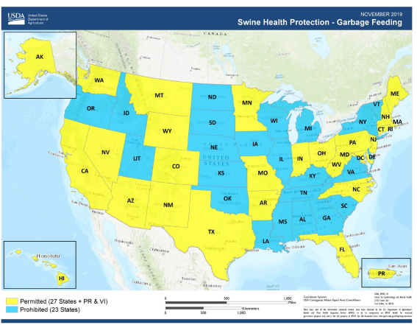
Notes:
Under the Swine Health Protection Act, owners must be licensed in order to feed their pigs human food waste that contains or has had contact with meat, poultry, or fish. The requirement applies to all garbage collected from food production establishments like restaurants, school cafeterias, and food processing plants.
The state also develops the structure for enforcing the Swine Health Protection Act in their state.

Slide 16
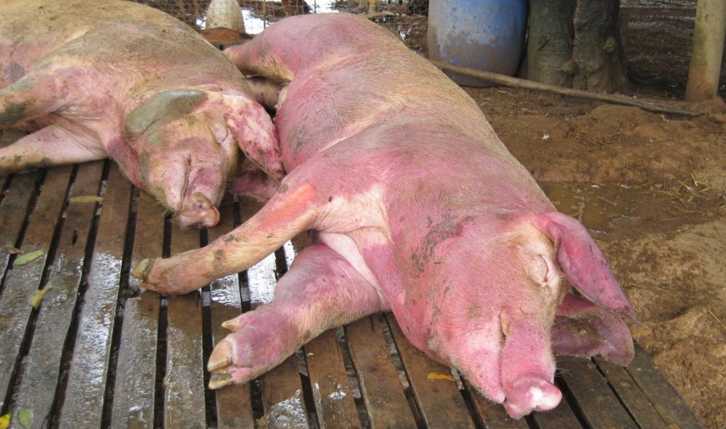
AFRICAN SWINE FEVER
Highly infectious and fatal hemorrhagic viral disease of pigs
Affects domestic and feral swine
Highly virulent strains can cause up to 100% mortality in naïve pigs
Incubation Period: 5-21 days following direct contact
No currently available treatment or vaccine
Not a threat to human health

Slide 17
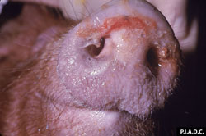
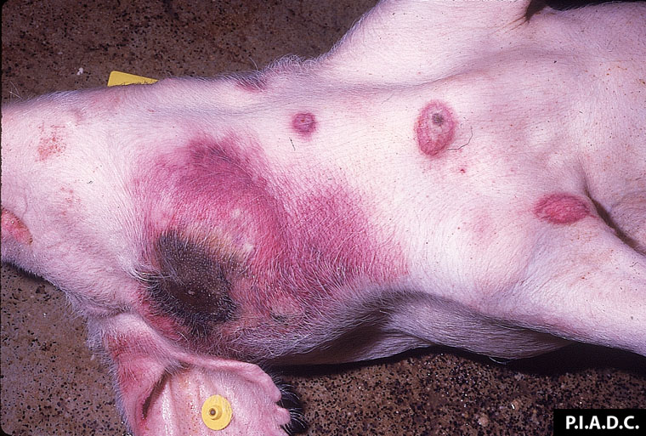
AFRICAN SWINE FEVER: CLINICAL DISEASE
High fever
Anorexia
Lethargy
Weakness, recumbency
Erythema, cyanosis
Hemorrhages
  Skin, snout

Slide 18
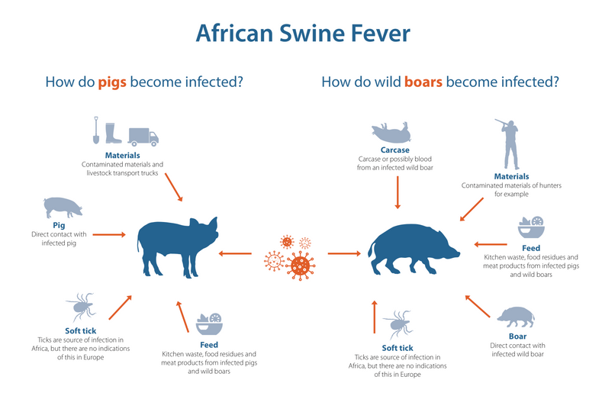
AFRICAN SWINE FEVER: TRANSMISSION
Important Facts:
Highly resistant in the environment
Survives:
  Over 140 days in pork products
  18 months in blood
  Months in contaminated pens

Slide 19
2005: WOAH began to collect data on ASF, known to be present in 32 African Countries
2007: ASF appears in East Europe
2014: Reported in European Union
2018: Emergence in Asia
2019/2020: Spread to Oceania and Papua New Guinea
2021: Reappearance in Western Hemisphere in Dominican Republic and Haiti

Slide 20
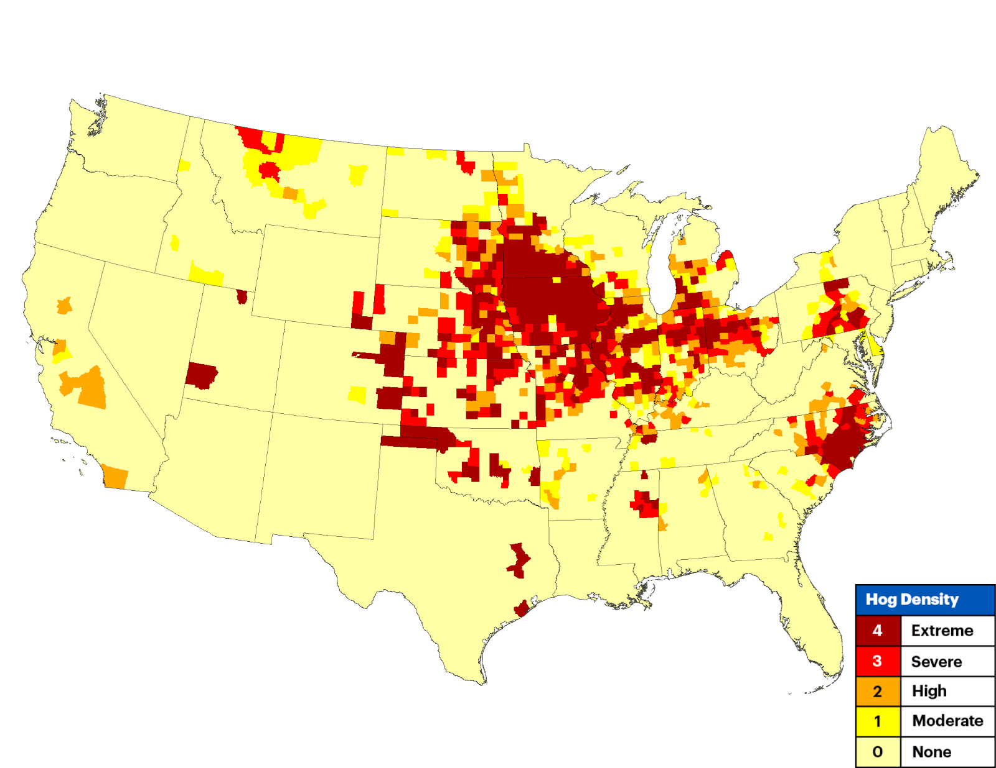
US PORK INDUSTRY IMPACTS
2023 more than 60,000 US pork producers marketed 136 million hogs valued at over $27 billion in gross cash receipts
Total Economic Contribution:
  573,000 jobs supported
  $62.7 billion in value added to GDP
  $37 Billion personal income generated

Slide 21
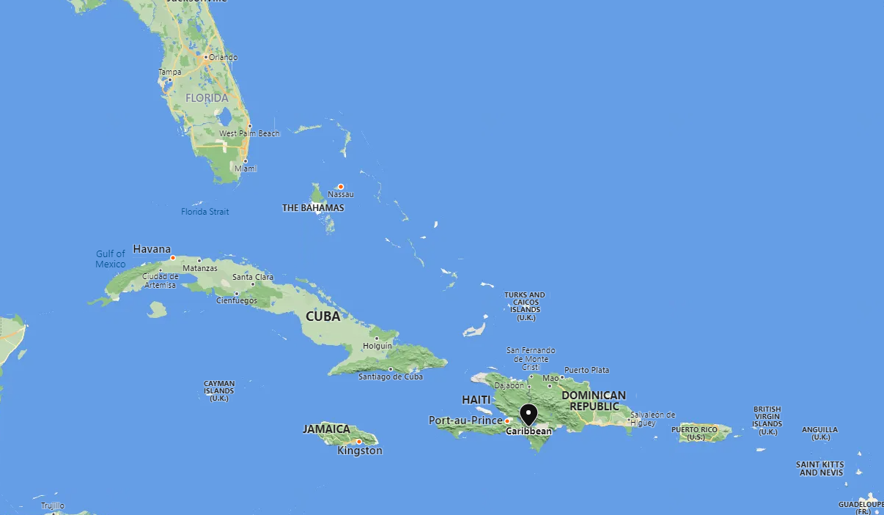
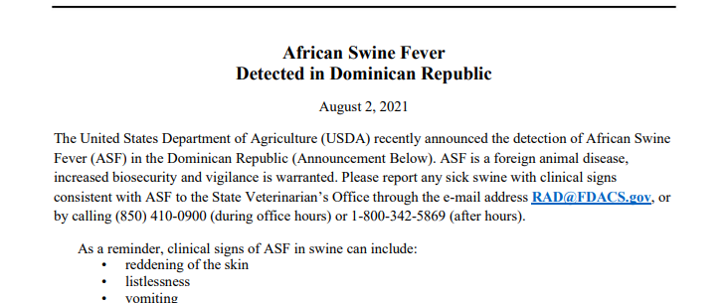
FDACS RESPONSE TO ASF
Increased producer outreach
  Fair Board Meetings
  Distributing brochures
  Garbage Feeder searches
Educating producers through site visits
Coordination with USDA-APHIS-VS and U.S. Customs and Border Protection

Slide 22
Foot and Mouth Disease (FMD)

Slide 23
Foot-and-mouth disease (FMD) is a severe, fast-spreading viral disease that primarily affects cloven-hooved animals, including cows, pigs, sheep, goats, and deer.
FMD is not a human health or food safety threat

Slide 24
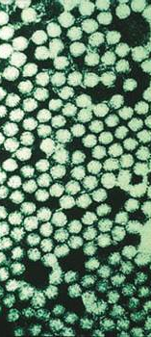
The Foot and Mouth Disease Virus (FMDV)
Genus = Aphthovirus
Family = Picornaviridae.
There are seven major viral serotypes: O, A, C, SAT 1, SAT 2, SAT 3 and Asia 1.
Serotype O is the most common serotype worldwide.
FOREIGN ANIMAL DISEASE
REPORTABLE ANIMAL DISEASE
Notes:
Non enveloped RNA virus
Over 60 strains
Minimal cross protection – significant impact on the ability to use vaccination
Vaccine must be made after outbreak has been detected.
Survives well in the environment, milk, bones, tissue, meat products

Slide 25
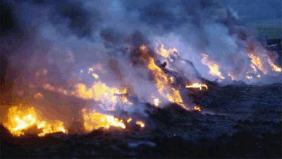
Why does it keep us up at night?
Foot and mouth disease is a high consequence livestock disease due to its potential for rapid spread, severe trade restrictions and the subsequent economic impacts that would result.

Slide 26
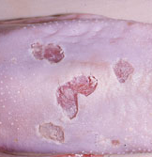
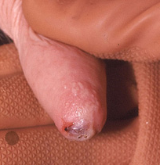
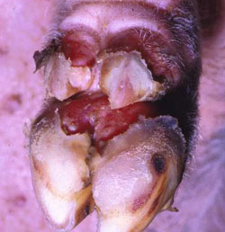
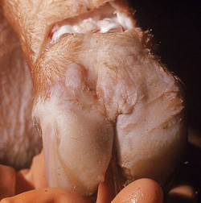
High Morbidity
Mixed Mortality
FMD causes painful sores and blisters on the feet, mouth and teats of animals.
Notes:
Mortality generally low
Mortality can be high in young animals and some wildlife species.
Sequelae may include decreased milk yield, permanent hoof
damage and chronic mastitis.
Presentation variable with species affected.

Slide 27
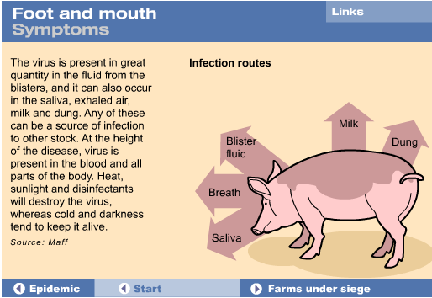

Slide 28
History
1929
1951-1952
1997
  United States
  9 outbreaks
  prior to 1929
    25 states
    6000 herds 300,000 animals
  All ended by eradication
  1929:
  Last case in U.S.
  Canada
  42 premises
  5000 animals
  $5 billion USD
  1952:
  Last case reported
  Taiwan
  6,147 premises
  4 million pigs depopulated
  $560 million USD
Notes:
Let’s look at a few examples of some outbreaks. Prior to 1929, FMD was present in several U.S. states, generally due to the importation of infected animals or their products. The largest outbreak was in 1914 as the virus spread throughout a Chicago stockyard. In 1929, restrictions were imposed on imported animals and products from infected countries, reducing the number of outbreaks. All of the outbreaks were controlled by stop movement and eradication of affected herds. In all, the U.S. had 9 outbreaks of FMD, involving 25 states, nearly 6,000 herds, and more than 300,000 animals. The U.S. has remained FMD free since the last outbreak in 1929. Similarly, FMD outbreaks occurred in Canada and Mexico. From 1951–1952, Canada had an FMD outbreak that affected only 42 premises and led to the depopulation of fewer than 5,000 animals.¹ However, the outbreak still cost approximately $722 million Canadian, plus one year’s loss of livestock and livestock product trade (nearly $5 billion USD in 2015 dollars). This outbreak demonstrates that even a small outbreak can have substantial economic impacts. FMD has not been reported in Canada since 1952.
A 1997 FMD epidemic in Taiwan resulted in the destruction of more than 4 million pigs on 6,147 premises. The epidemic cost the country roughly $560 million USD when indemnities, vaccines, carcass disposal, and loss of market value were considered.²

Slide 29
History
2001
2010-2011
2017-2025
  United Kingdom
  6.5 million animals depopulated
  3.1 billion pounds in losses
  3 billion pounds from lost tourism
  10 billion USD total
  Spread to other European countries
  South Korea
  3700 farms
  3.5 million cattle and pigs depopulated
  $1.9 billion USD
  Outbreaks continue to occur in endemic and FMD free countries
Notes:
One of the largest foot and mouth disease outbreaks in recent history occurred in the United Kingdom in 2001. resulting in total estimated losses of approximately(~$6.3 billion USD dollars) from losses in agriculture and the food chain, plus an addition 2.7 to 3.2 billion pounds from lost tourism (roughly 10 billion U.S. dollars total).¹ The United Kingdom attempted FMD control and elimination through a ring depopulation and “stamping out” approach. All susceptible animals within a 3 kilometer radius, regardless of infection status, were depopulated. More than 4 million animals were destroyed to control this disease, and an additional 2.5 million were euthanized for welfare reasons. Despite all control and elimination efforts, the virus spread from the United Kingdom to Ireland and mainland Europe, including France and the Netherlands.
A 2010-2011 outbreak in South Korea was the largest ever to be reported for that country, with about 3,700 farms affected. Both depopulation and emergency vaccination were implemented; nearly 3.5 million cattle and pigs were depopulated. This outbreak has caused estimated losses of nearly $1.9 billion USD in 2015 dollars. Sporadic outbreaks continued to occur in South Korea during 2016 and 2017. These outbreaks have occurred despite vaccination efforts being used in the country since 2010. All of these outbreaks demonstrate that despite control efforts, the disease spreads quickly, affects large numbers of animals, and results in substantial economic impacts. Many countries had long periods of freedom from the disease prior to their outbreaks.

Slide 30
Currently
January 2025
March 2025
Ongoing
Germany
Water Buffalo
Serotype O
First detection since 1988
Slovakia
Cattle
Serotype O More than 50 years since last detection
Africa
Mideast
South Asia
China
Korea
Hungary
Dairy cattle
Serotype O
More than 50 years since last detection
Notes:
Multiple African countries including South Africa, Zambia, Namibia, Mozambique, Algeria, (Burkina Faso & Libya 2025)
Mideast areas from Turkey, Jordan, Palestine, Iran, Bahrain, (Iraq, Israel 2025)
South Asia including Bangladesh, India, (Cambodia 2025)
China and Korea 2025

Slide 31
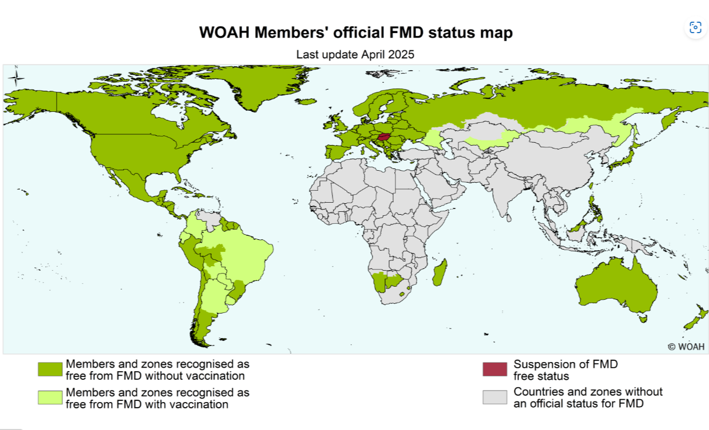
Currently
https://wahis.woah.org/
Notes:
Official status on this map has a significant impact on the industries within each country. Trade restrictions center on the status of a country or region. This trade includes not only live animals but also animal products.
This map is updated by WOAH, the World Organization for Animal Health.
The countries in green, are recognized as free from FMD without vaccination, The countries in lighter green are recognized as free from FMD with vaccination, and the countries in red are recognized no longer being free of FMD
The countries in tan are zones without an official status for FMD.
Map of FMD events since April 2025. Reported to WOAH.

Slide 32
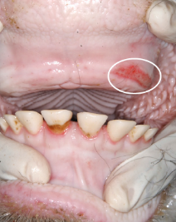
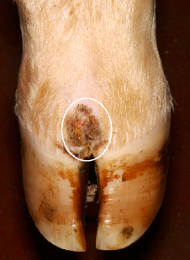
Differential Diagnoses
Bluetongue Virus – BTV
Bovine Viral Diarrhea - BVD
Epizootic Hemorrhagic Disease Virus – EHD
Infectious Bovine Rhinotracheitis - IBR
Malignant Catarrhal Fever – MCF
Orf – Contagious Soremouth – sheep [Zoonotic]
Seneca Virus A - swine
Vesicular Exanthema of Swine
Vesicular Stomatitis – also horses

Slide 33
Scary details
Mechanical and fomite transmission
Forage and bedding
Vehicles, boots
Meat products or rendering
Secretions, excretions and tissues
Nasal passages/respiratory tract of humans
Aerosol and wind dispersal
Great distances (>100 miles)
Notes:
Most studies suggest the virus remains viable, on average, for 3 months or less in the environment. In colder environments, longer survival up to 6 months may be possible
The virus may persist in meat, and milk and milk products.

Slide 34
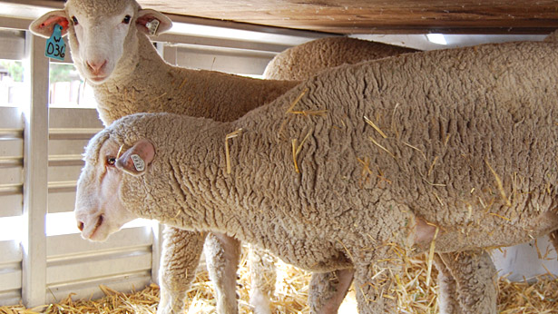
Animal Movement in the US
~1,000,000 pigs daily
~50,000 to 83,000 feedlot placements per day
~100,000 to 120,000 commercial cattle slaughtered per day
Dairy calves and heifer replacements?
Auction market, fair exhibitors?
Sheep, goats, other?
Wildlife (feral swine and deer)?

Slide 35


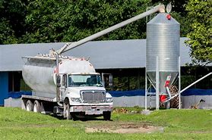
Other Associated Movement in the US
ØFeed and other on farm deliveries
ØShared-work crews, repair personnel, equipment
ØEmployees
ØVeterinarians
ØMilk trucks and other vehicles
Notes:
Amazon; Duke Energy; AI technicians;

Slide 36
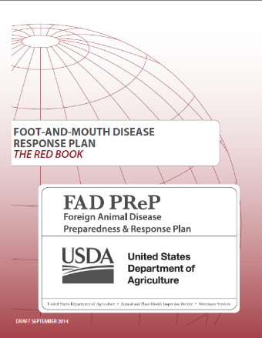
Preparedness: U.S.
Federal response plans - FAD PReP
  www.aphis.usda.gov/fadprep
State planning exercises
Suspicious lesions investigated
Biosecurity protocols for livestock facilities
Notes:
The U.S. Department of Agriculture has upgraded the safeguarding measures in place to prevent introduction of FMDV into the United States. APHIS has developed federal response plans and strategies should FMD occur on U.S. soil. There are approximately 450 foreign animal disease diagnosticians (FADD) trained to investigate suspicious lesions and other unusual symptoms that private veterinary practitioners alert them to. Numerous states have also been involved in training exercises regarding actions to take if FMD is introduced. Producers should implement and follow strict, complete biosecurity protocols on U.S. livestock production facilities as their best means of prevention.
[Photo: Cover of the USDA Foreign Animal Disease Preparedness and Response Plan (FAD PReP) Foot-and-Mouth Disease Response Plan. Source: USDA]

Slide 37
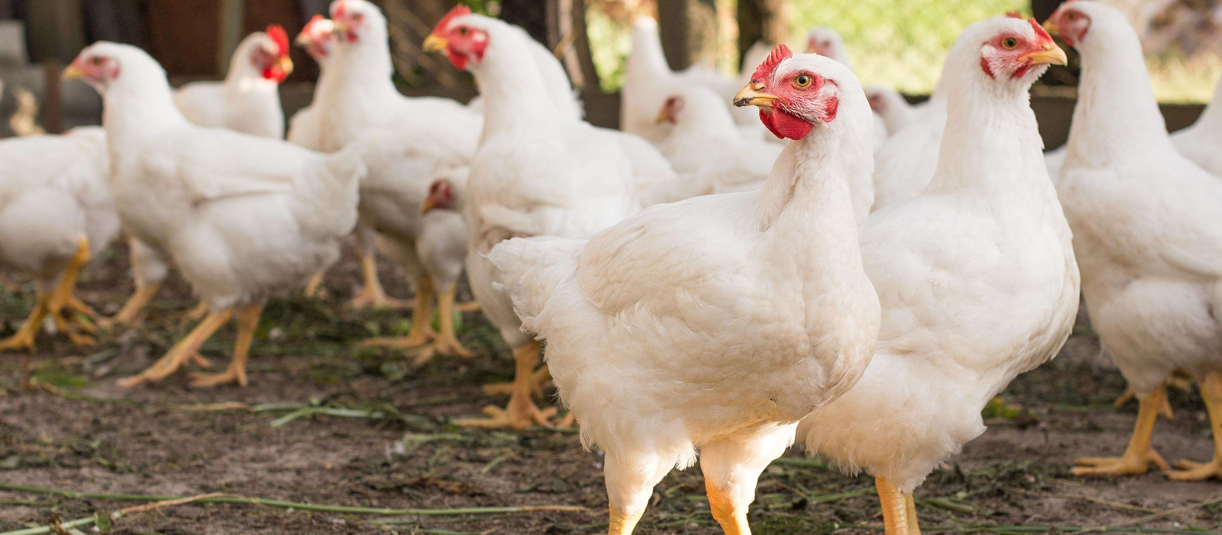
Highly Pathogenic Avian Influenza (HPAI)

Slide 38
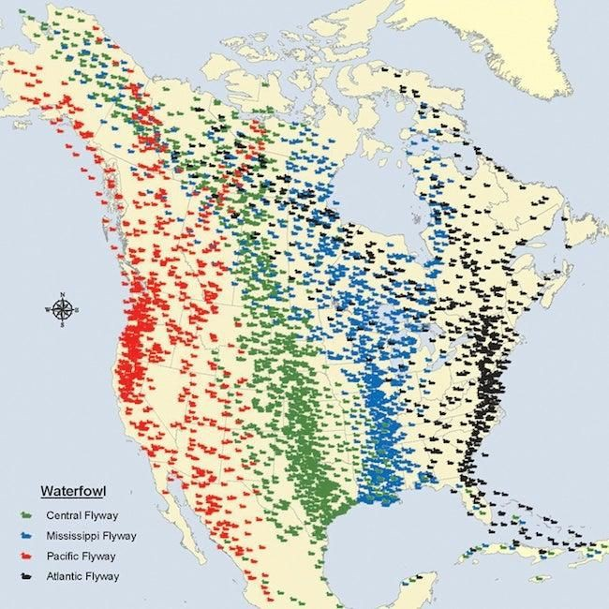
Highly Pathogenic Avian Influenza
Avian Influenza
Influenza A Virus
Carried by waterfowl and shorebirds - globally
Classified into subtypes based on surface proteins (H’s, N’s)
e.g., H5N1, H3N2
H5, H7 - highly pathogenic
Causes severe disease in poultry
Chickens, turkeys, pheasants, quail, ducks, geese, etc.
>90% morbidity and mortality rate
Occasional spillover into other mammals Varying clinical signs and mortality Zoonotic potential

Slide 39
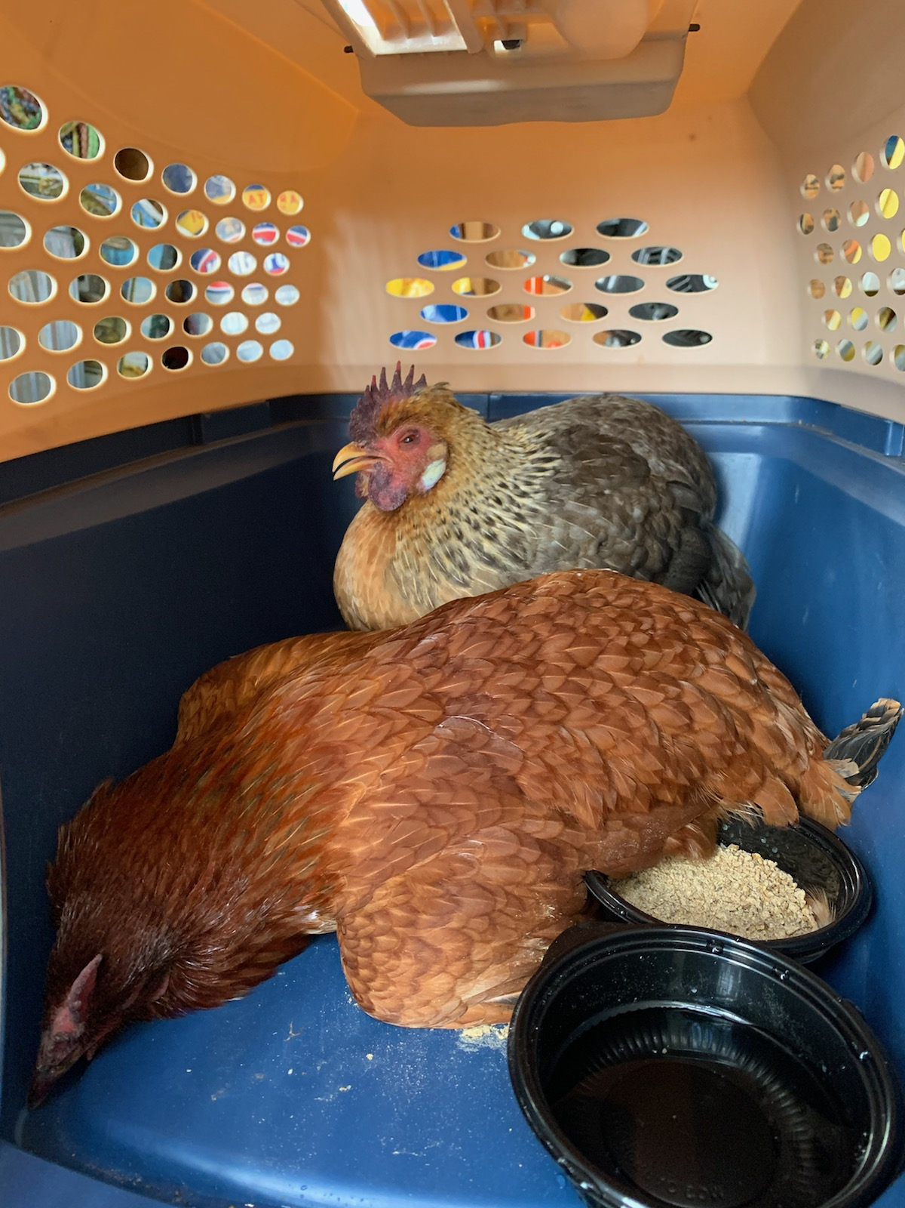
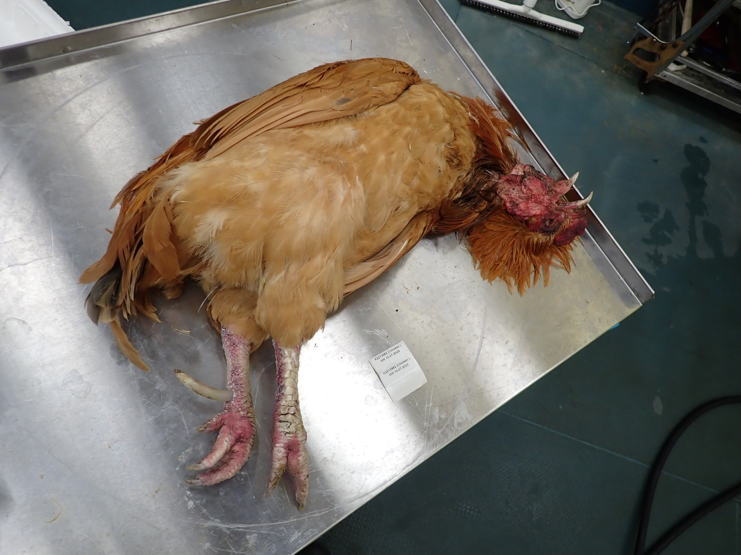

HPAI Signs of Illness
Notes:
Lack of energy and appetite
Decreased water consumption before onset of clinical disease
Decreased egg production or soft-shelled or misshapen eggs
Swelling of head, comb, eyelid, wattles, and hocks
Purple discoloration of wattles, comb, and legs
Nasal discharge, coughing, and sneezing
Incoordination
Diarrhea or
Sudden death without clinical signs

Slide 40
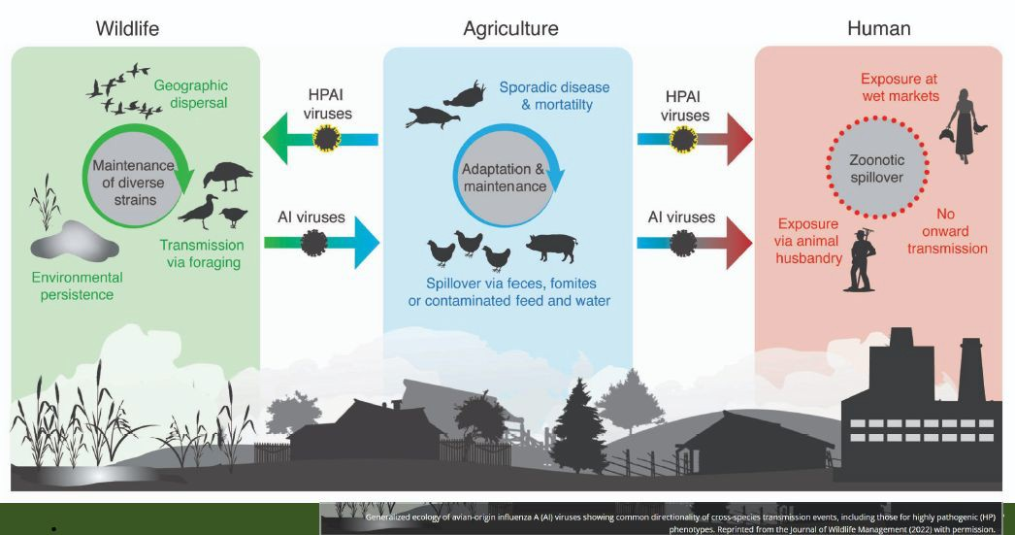

Slide 41
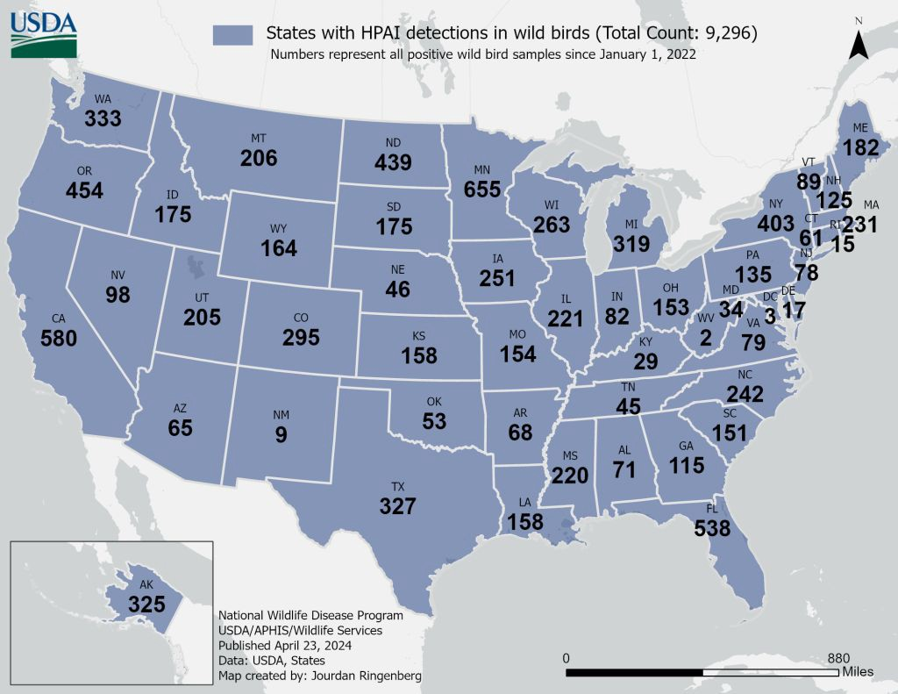
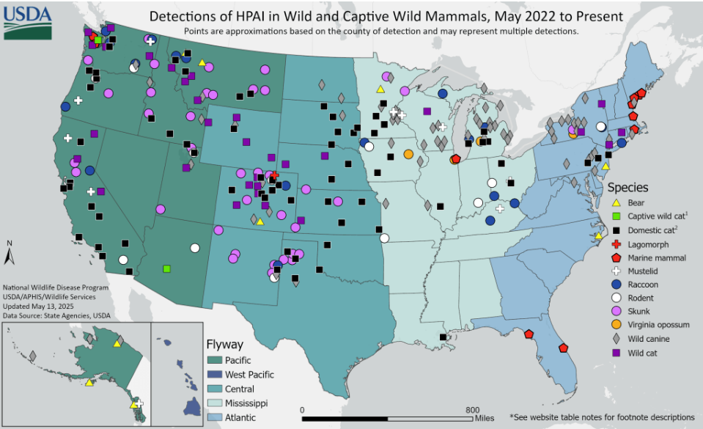
HPAI in Wild Birds and Wild Mammals
https://www.aphis.usda.gov/livestock-poultry-disease/avian/avian-influenza/hpai-detections/mammals

Slide 42
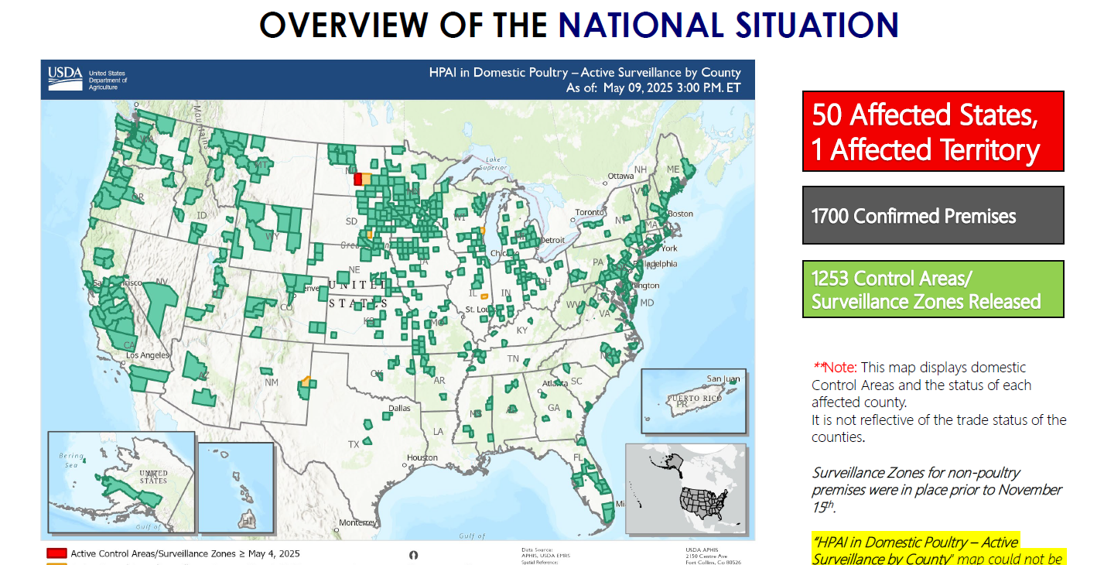

Slide 43
Florida HPAI cases in poultry cases in poultry
50 H5N1 positive poultry premises
32 WOAH Non-poultry premises (Backyard)
18 WOAH Poultry premises
No commercial poultry premises
Geographically
18 counties
Duval to Miami Dade
Miami-Dade – 11 cases
July 2022 to May 2025

Slide 44
And then there was ….
Bovine Associated Influenza A Syndrome (HPAI H5N1)

Slide 45
Emerging Disease – Evolving Situation
Mid February 2023 recognition of cluster of dairy cattle cases in TX and KS
Clinical similarities – unknown cause
  Dramatic decrease of production
  Thick yellow milk
  Decreased appetite and rumen activity

Slide 46
Emerging Disease – Evolving Situation
Multiple agencies and companies engaged
Additional cases, plus
  Barn cat mortalities
  Dairy worker with conjunctivitis

Slide 47
Emerging Disease – Evolving Situation
Initial introduction from wild birds
High viral load in MILK
Amplifying in mammary tissue
Evidence of virus in tissues highly variable
Lateral Transmission occurring
Within dairies
Between dairies (Interstate movement)
Between sectors of agriculture (poultry)

Slide 48
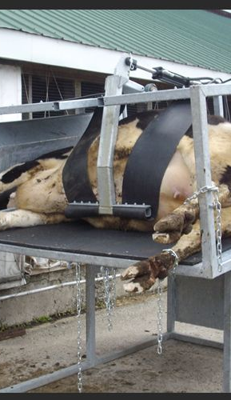
Emerging Disease – Evolving Situation
Lateral transmission (mechanical)
  Unpasteurized milk
  Fomites
    Equipment – front end loaders, trailers
    Humans – AI technicians, dead stock removal companies, hoof trimmers, vets, workers
    Vehicles – livestock haulers, dead stock removal companies, feed delivery

Slide 49
MORE QUESTIONS THAN ANSWERS – BUT MANY ARE WORKING TO GET ANSWERS
Good news is:
  No evidence of genetic shift to be more transmissible to humans
  CDC and FDA messages supporting continued consumption of pasteurized milk and safety of beef products

Slide 50
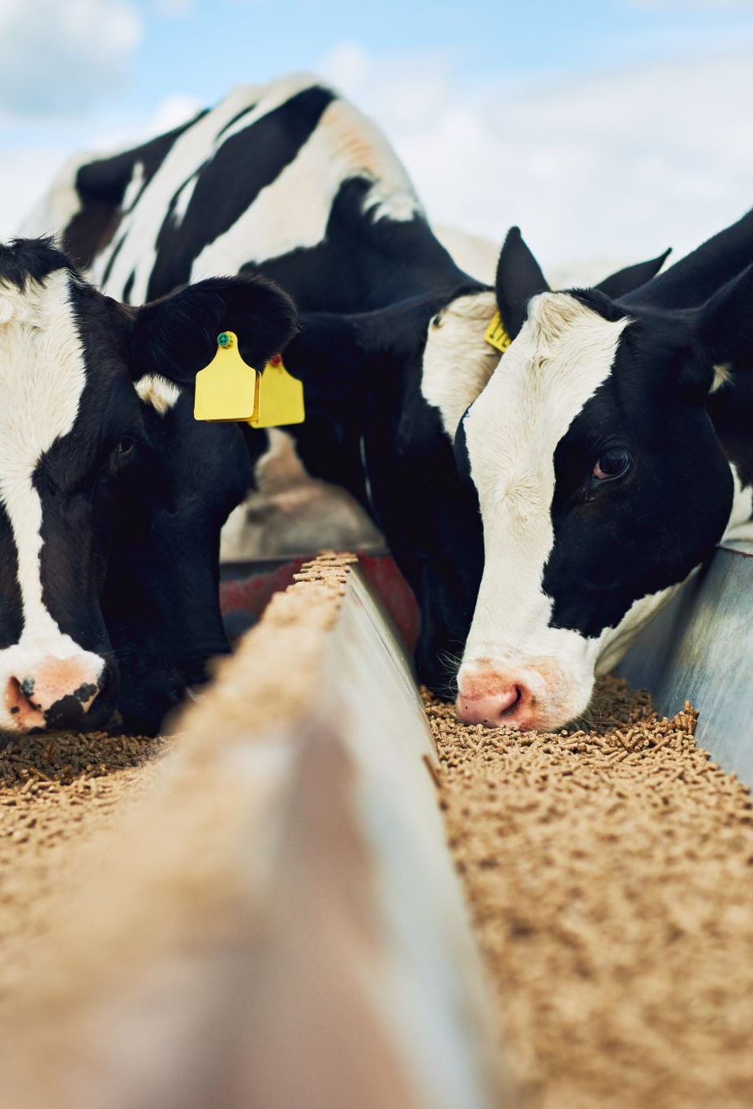
National Response to the Emerging Disease Event
Multiple agencies
  CDC – Human health component
  FDA – Food safety component
  USDA – Animal health and industries
Concern related to potential adaption of virus – human threat
Goal of response is to STAMP OUT this disease in dairy cattle
Much research is ongoing – Response is evolving

Slide 51

Reportable Animal Disease
Bronson Animal Disease Diagnostic Laboratory available to perform testing
Testing must be coordinated as an Emerging Disease Investigation, report online or contact Dr. Kitchen (850-251-1225)

Slide 52
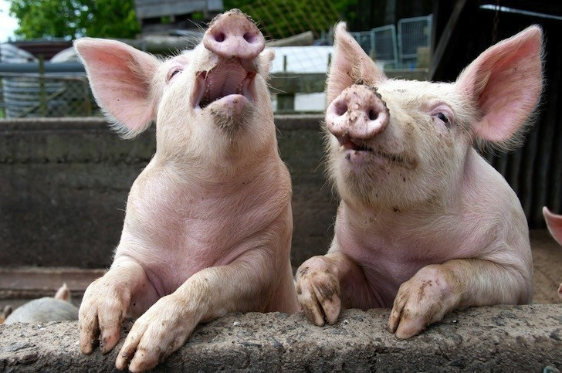
Questions?

